Slide 1

Climate Change And Sustainable Practices
By- Dhruv Narang

Slide 2
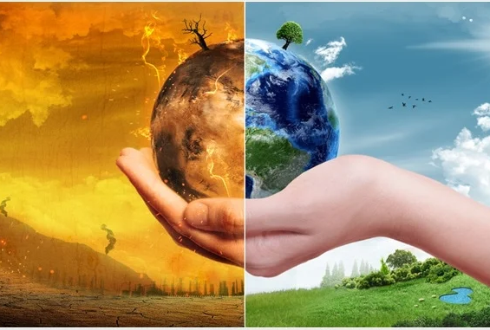
Agenda
Introduction
Cause and effect of climate change
What are Sustainable Practices?
practices to combat climate change
Summary

Slide 3
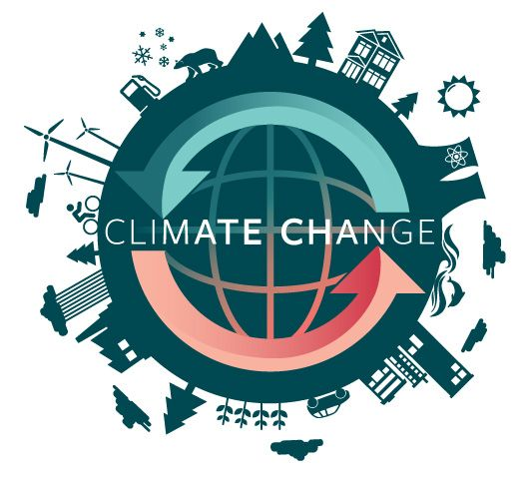
Introduction
“Climate change refers to long-term shifts in temperatures and weather patterns.”
The main cause of climate change is the excessive emission of greenhouse gases, primarily carbon dioxide, which traps heat in the Earth's atmosphere and causes the planet to warm up.

Slide 4

Cause & it’s effect

Slide 5
Cause of climate change
Generating Power: Most electricity is still generated by burning coal, oil, or gas, which produces carbon dioxide and nitrous oxide.
Manufacturing Goods: Manufacturing and industry produce emissions, mostly from burning fossil fuels to produce energy for making things like cement, iron, steel, electronics, plastics, clothes, and other goods.
Cutting Down Forests(Deforestation): Each year approximately 12 million hectares of forest are destroyed.
Using Transportation: Transportation is a major contributor of greenhouse gases, especially carbon dioxide emissions.
Producing Food: Producing food causes emissions of carbon dioxide, methane, and other greenhouse gases in various ways
Power Building: Globally, residential and commercial buildings consume over half of all electricity.
Consuming Too Much Energy: The wealthiest bear the greatest responsibility: the richest 1 per cent of the global population combined account for more greenhouse gas emissions than the poorest 50 per cent.

Slide 6
Effect of climate change
Hotter temperatures: The last decade, 2011-2020, is the warmest on record.
More severe storms: Cyclones, hurricanes, and typhoons feed on warm waters at the ocean surface.
Increased drought: Deserts are expanding, reducing land for growing food.
A warming, rising ocean: The rate at which the ocean is warming strongly increased over the past two decades, across all depths of the ocean.
Loss of species: The world is losing species at a rate 1,000 times greater than at any other time in recorded human history.
Not enough food: Climate changes and extreme weather events are among the reasons behind a global rise in hunger and poor nutrition.
More health risks: Climate change is humanity’s biggest health threat.
Poverty and displacement: Floods may sweep away urban slums, destroying homes and livelihoods.

Slide 7
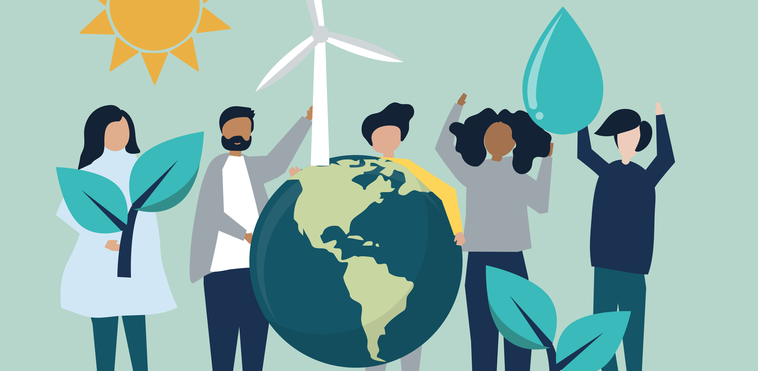
Sustainable practices are things we can do to help our environment develop in all the ways that our future generations have all the resources provided by nature to fulfil their needs.
What are Sustainable Practices?

Slide 8


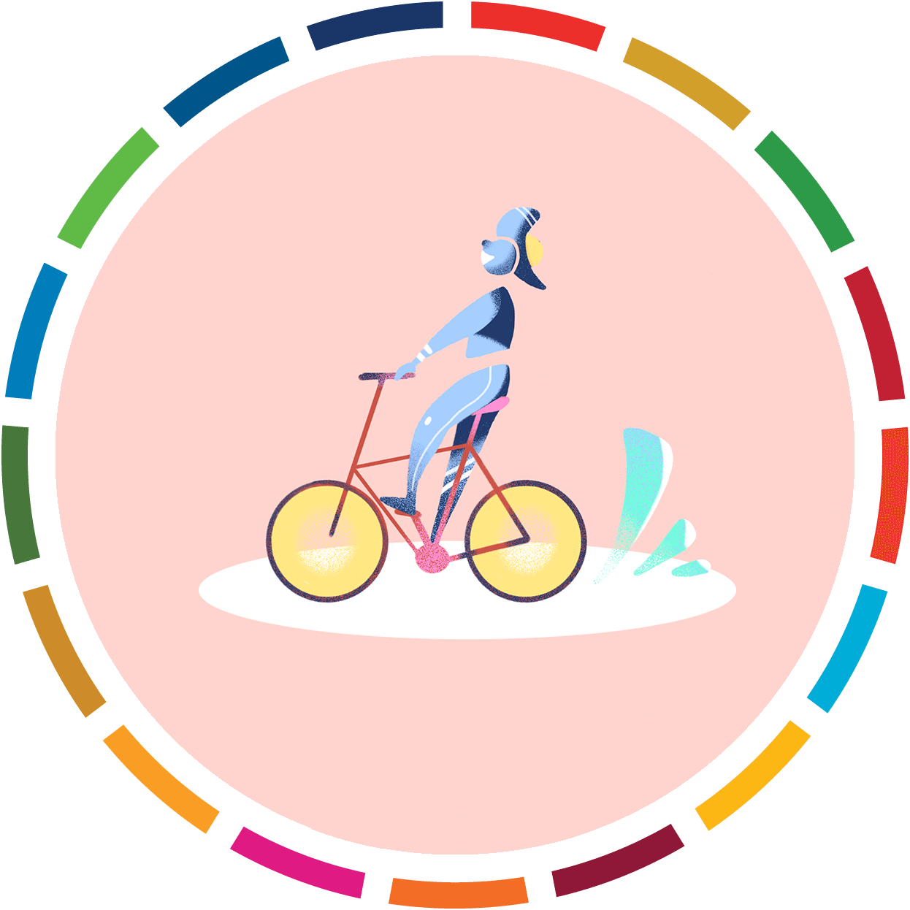


sustainable practices to combat climate change
Renewable energy: Renewable energy sources, such as solar, wind, wave, biomass, geothermal, and hydroelectric, are clean and don't produce greenhouse gas emissions.
Sustainable transportation: Walk, bike, or take public transportation. For longer distances, consider taking a train or bus. Carpooling whenever possible can also help.
Energy efficiency: Reducing energy use in buildings can help.
Sustainable agriculture: Better forestry management and sustainable agriculture can help.
Circular economy practices: Embracing circular economy practices can help.
Afforestation: Plant More Trees.
Reduce, Reuse And Recycle: To protect the climate, buy fewer things, shop second-hand, and repair what you can.

Slide 9

Thank You

